Slide 1
Vzorkovanie signálov
Číslicové Spracovanie Signálov - CVIČENIA
doc. Ing. Ondrej Kováč, PhD.
Ing. Antónia Kováčová

Slide 2
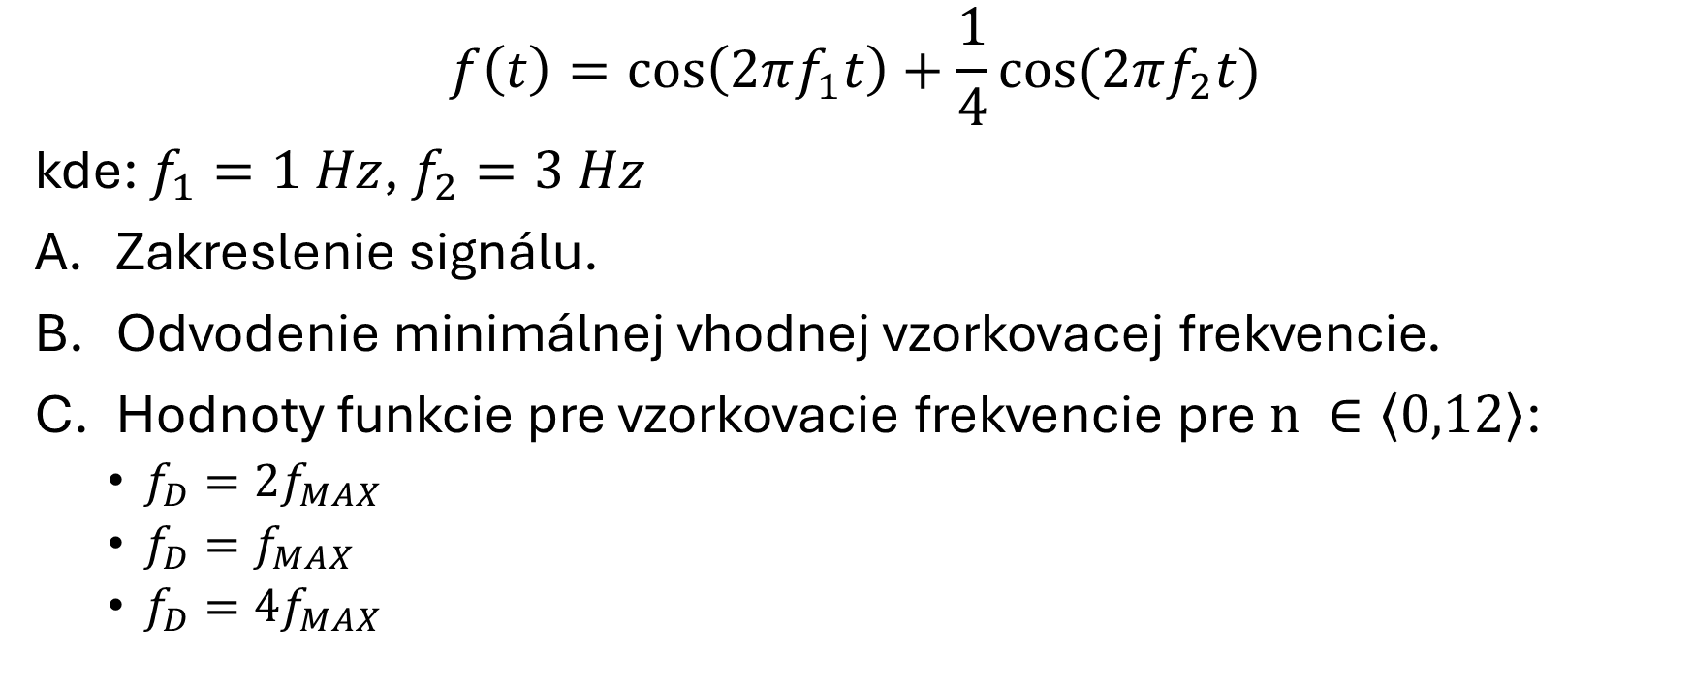
Úloha 1
$$f\left(t\right)=\cos\left(2πf_{1}t\right)+\frac{1}{4}cos⁡(2πf_{2}t)$$
kde: $f_{1}=1 Hz$, $f_{2}=3 Hz$
Zakreslenie signálu.
Odvodenie minimálnej vhodnej vzorkovacej frekvencie.
Hodnoty funkcie pre vzorkovacie frekvencie pre$n ∈\left\langle 0,12\right\rangle$:
  $f_{D}={2f}_{MAX}$
  $f_{D}=f_{MAX}$
  ${f_{D}=4f}_{MAX}$

Slide 3
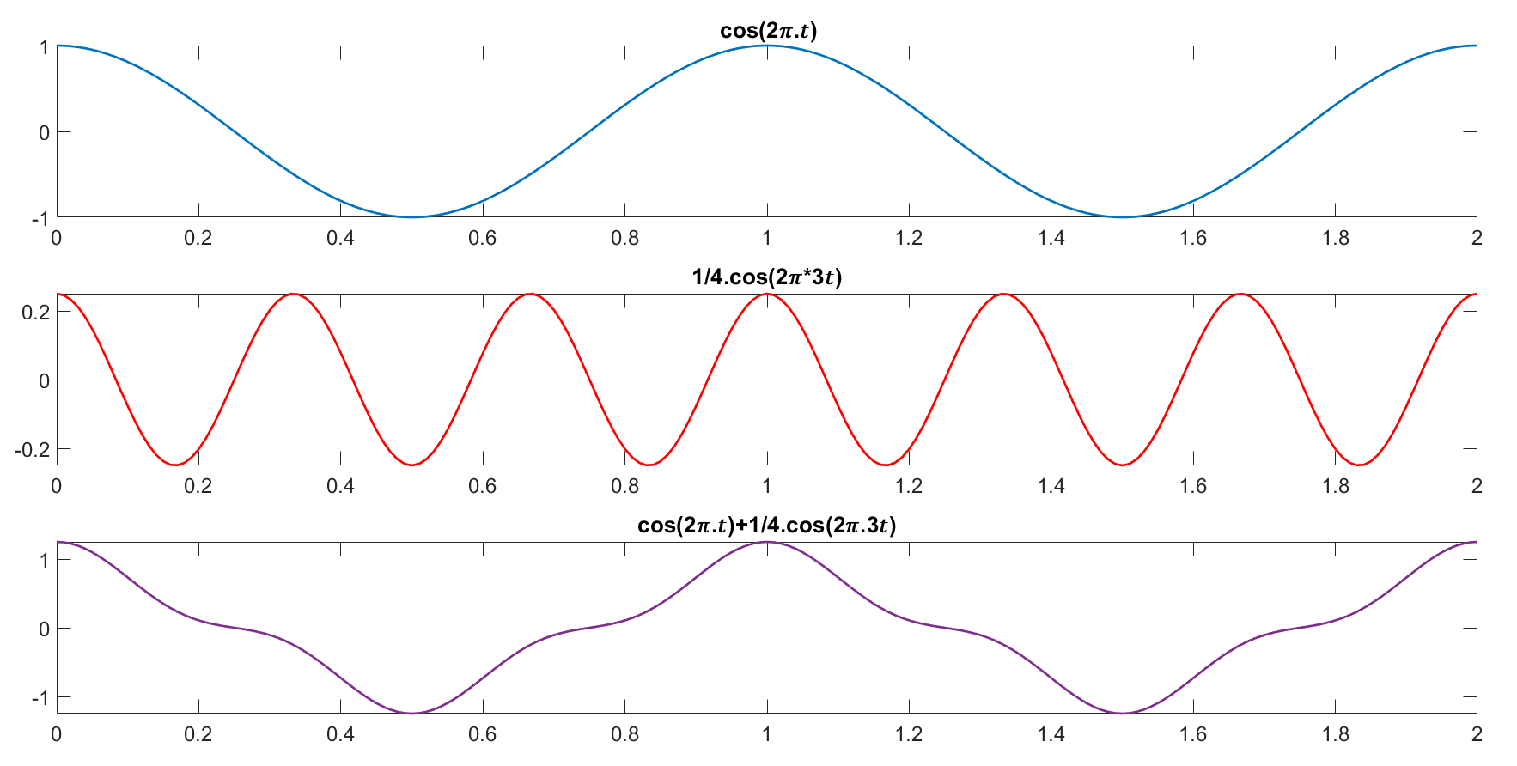
Úloha 1a) – riešenie

Slide 4
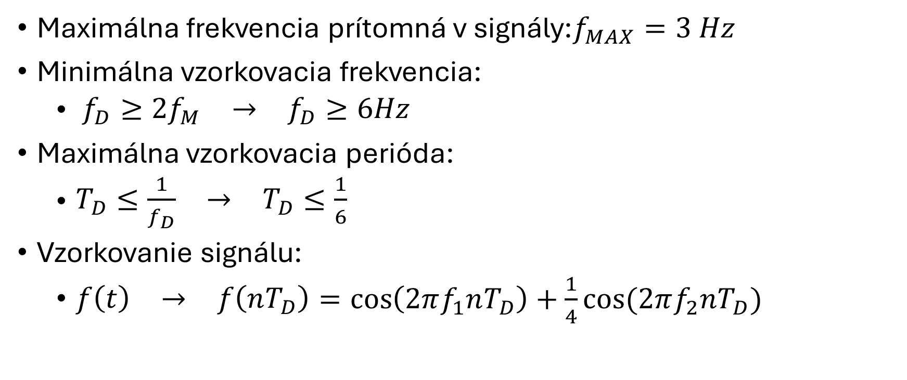
Úloha 1b) – riešenie
Maximálna frekvencia prítomná v signály:$f_{MAX}=3 Hz$
Minimálna vzorkovacia frekvencia:
  $\begin{matrix}f_{D}≥{2f}_{M} & → & f_{D}≥6Hz\end{matrix}$
Maximálna vzorkovacia perióda:
  $\begin{matrix}T_{D}≤\frac{1}{f_{D}} & → & T_{D}≤\frac{1}{6}\end{matrix}$
Vzorkovanie signálu:
  $\begin{matrix}f\left(t\right) & → & f\left(nT_{D}\right)\end{matrix}=\cos\left(2πf_{1}nT_{D}\right)+\frac{1}{4}cos⁡(2πf_{2}nT_{D})$

Slide 5
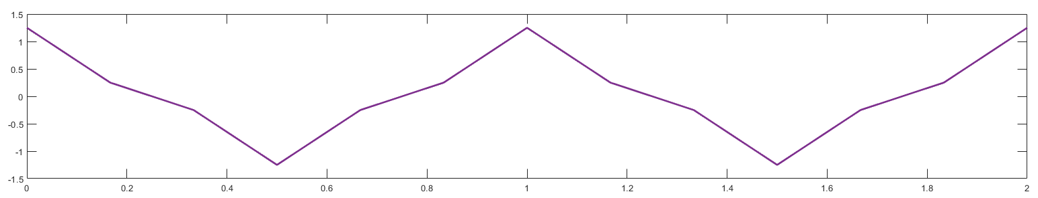

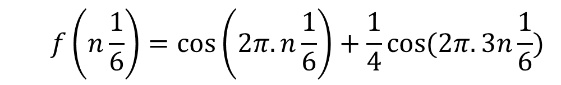
Úloha 1c) – riešenie, $f_{D}={2f}_{MAX}$
  $$f\left(n\frac{1}{6}\right)=\cos\left(2π.n\frac{1}{6}\right)+\frac{1}{4}cos⁡(2π.3n\frac{1}{6})$$
n | 0 | 1 | 2 | 3 | 4 | 5 | 6 | 7 | 8 | 9 | 10 | 11 | 12
nTd | 0 | 0.167 | 0.333 | 0.5 | 0.667 | 0.833 | 1 | 1.167 | 1.333 | 1.5 | 1.667 | 1.833 | 1.167
f(nTd) | 1.25 | 0.25 | -0.25 | -1.25 | -0.25 | 0.25 | 1.25 | 0.25 | -0.25 | -1.25 | -0.25 | -1.25 | -0.25

Slide 6
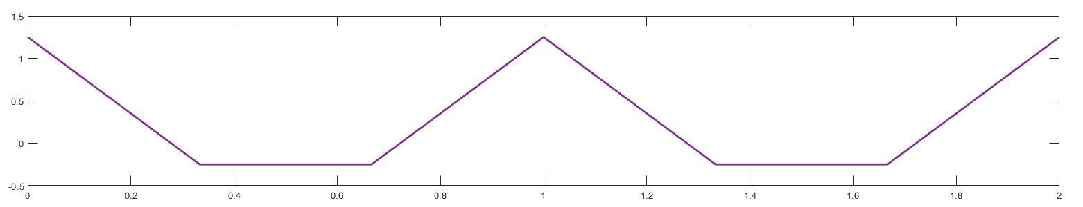
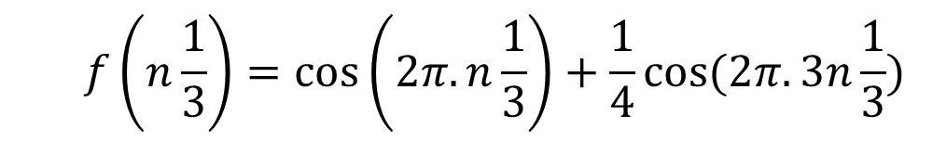

Úloha 1c) – riešenie, $f_{D}=f_{MAX}$
  $$f\left(n\frac{1}{3}\right)=\cos\left(2π.n\frac{1}{3}\right)+\frac{1}{4}cos⁡(2π.3n\frac{1}{3})$$
n | 0 | 1 | 2 | 3 | 4 | 5 | 6 | 7 | 8 | 9 | 10 | 11 | 12
nTd | 0 | 0.333 | 0.667 | 1 | 1.333 | 1.667 | 2 | 2.333 | 2.667 | 3 | 3.333 | 3.667 | 4
f(nTd) | 1.25 | -0.25 | -0.25 | 1.25 | -0.25 | -0.25 | 1.25 | -0.25 | -0.25 | 1.25 | -0.25 | -0.25 | 1.25

Slide 7
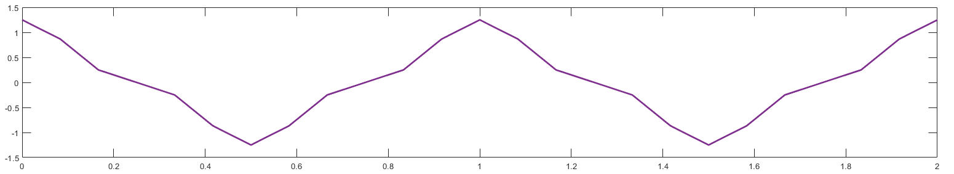
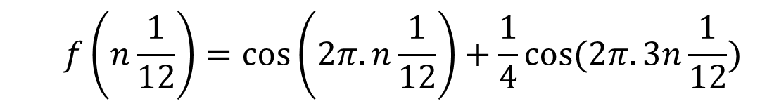

Úloha 1c) – riešenie, $f_{D}=4f_{MAX}$
  $$f\left(n\frac{1}{12}\right)=\cos\left(2π.n\frac{1}{12}\right)+\frac{1}{4}cos⁡(2π.3n\frac{1}{12})$$
n | 0 | 1 | 2 | 3 | 4 | 5 | 6 | 7 | 8 | 9 | 10 | 11 | 12
nTd | 0 | 0.083 | 0.167 | 0.25 | 0.334 | 0.417 | 0.5 | 0.583 | 0.667 | 0.75 | 0.833 | 0,917 | 1
f(nTd) | 1.25 | 0.87 | 0.25 | 0 | -0.25 | -0.87 | -1.25 | -0.87 | -0.25 | 0 | 0.25 | 0.87 | 1.25

Slide 8
Úloha 1c) – riešenie, $f_{D}=4f_{MAX}$
  $$f\left(n\frac{1}{12}\right)=\cos\left(2π.n\frac{1}{12}\right)+\frac{1}{4}cos⁡(2π.3n\frac{1}{12})$$
n | 0 | 1 | 2 | 3 | 4 | 5 | 6 | 7 | 8 | 9 | 10 | 11 | 12
nTd | 0 | 0.083 | 0.167 | 0.25 | 0.333 | 0.417 | 0.5 | 0.583 | 0.667 | 0.75 | 0.833 | 0,917 | 1
f(nTd) | 1.25 | 0.87 | 0.25 | 0 | -0.25 | -0.87 | -1.25 | -0.87 | -0.25 | 0 | 0.25 | 0.87 | 1.25
NESPRÁVNA REKONŠTRUKCIA

Slide 9
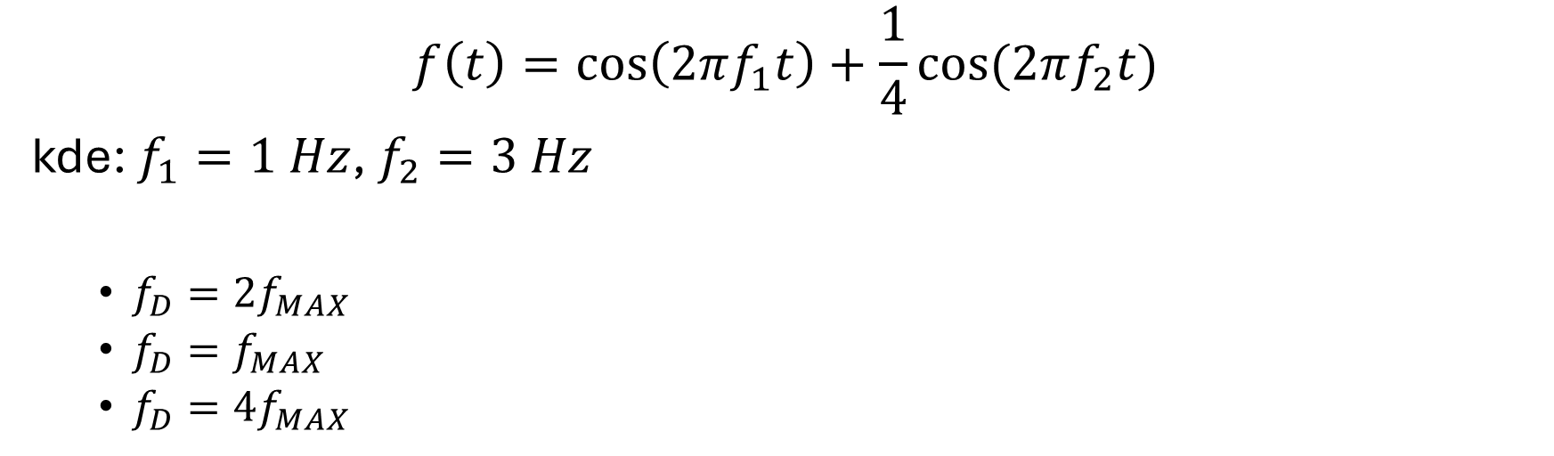
Úloha 2
Rekonštrukcia vzoriek pre signál z úlohy 1 pomocou Shannon-Kotelníkového rádu.
$$f\left(t\right)=\cos\left(2πf_{1}t\right)+\frac{1}{4}cos⁡(2πf_{2}t)$$
kde: $f_{1}=1 Hz$, $f_{2}=3 Hz$
  $f_{D}={2f}_{MAX}$
  $f_{D}=f_{MAX}$
  ${f_{D}=4f}_{MAX}$

Slide 10
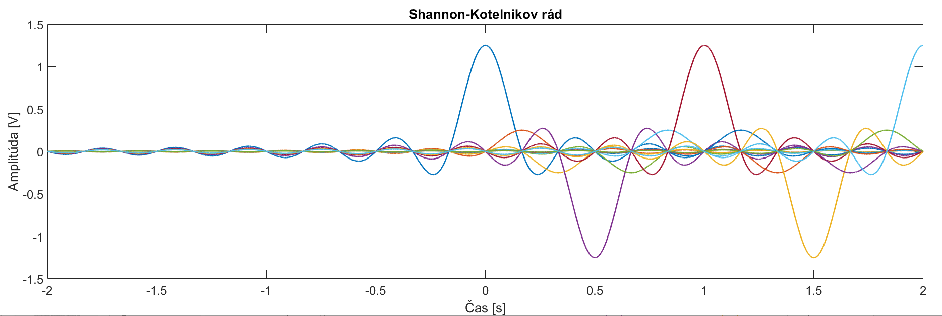

Úloha 2 – riešenie, $f_{D}={2f}_{MAX}$
n | 0 | 1 | 2 | 3 | 4 | 5 | 6 | 7 | 8 | 9 | 10 | 11 | 12
nTd | 0 | 0.167 | 0.333 | 0.5 | 0.667 | 0.833 | 1 | 1.167 | 1.333 | 1.5 | 1.667 | 1.833 | 1.167
f(nTd) | 1.25 | 0.25 | -0.25 | -1.25 | -0.25 | 0.25 | 1.25 | 0.25 | -0.25 | -1.25 | -0.25 | -1.25 | -0.25

Slide 11
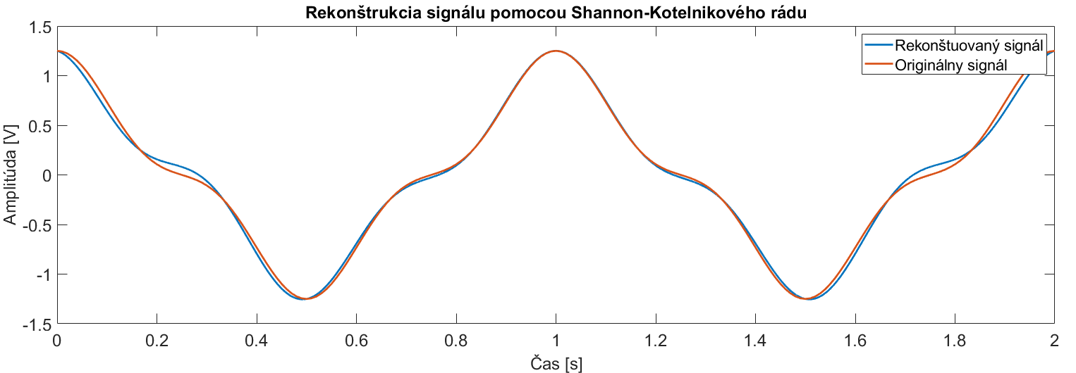
Úloha 2 – riešenie, $f_{D}={2f}_{MAX}$
n | 0 | 1 | 2 | 3 | 4 | 5 | 6 | 7 | 8 | 9 | 10 | 11 | 12
nTd | 0 | 0.167 | 0.333 | 0.5 | 0.667 | 0.833 | 1 | 1.167 | 1.333 | 1.5 | 1.667 | 1.833 | 1.167
f(nTd) | 1.25 | 0.25 | -0.25 | -1.25 | -0.25 | 0.25 | 1.25 | 0.25 | -0.25 | -1.25 | -0.25 | -1.25 | -0.25

Slide 12
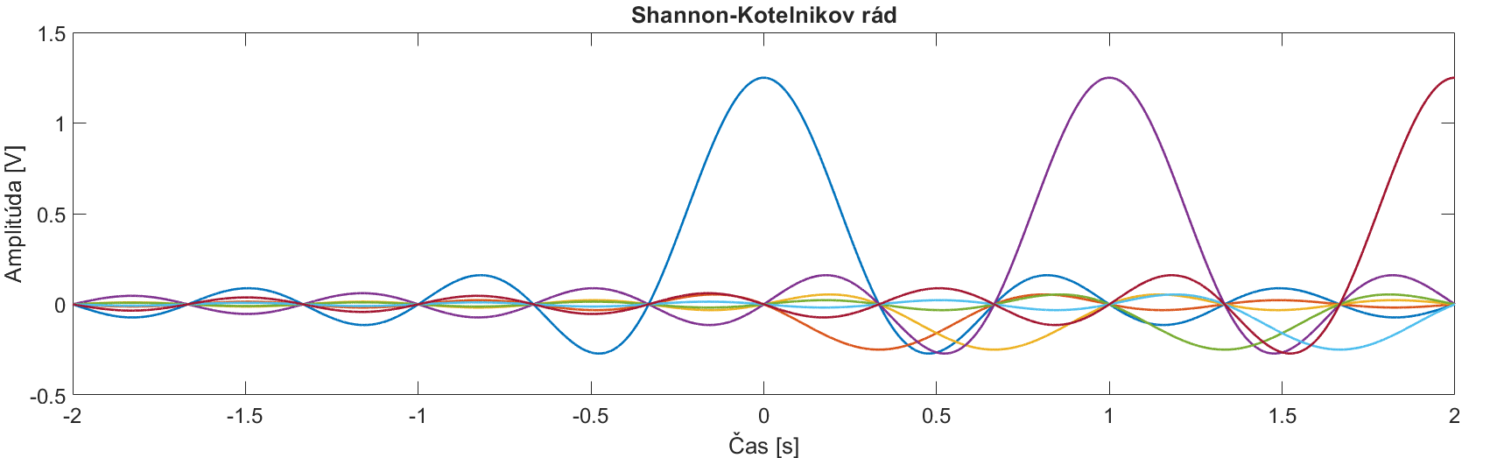

Úloha 2 – riešenie, $f_{D}=f_{MAX}$
n | 0 | 1 | 2 | 3 | 4 | 5 | 6 | 7 | 8 | 9 | 10 | 11 | 12
nTd | 0 | 0.333 | 0.667 | 1 | 1.333 | 1.667 | 2 | 2.333 | 2.667 | 3 | 3.333 | 3.667 | 4
f(nTd) | 1.25 | -0.25 | -0.25 | 1.25 | -0.25 | -0.25 | 1.25 | -0.25 | -0.25 | 1.25 | -0.25 | -0.25 | 1.25

Slide 13
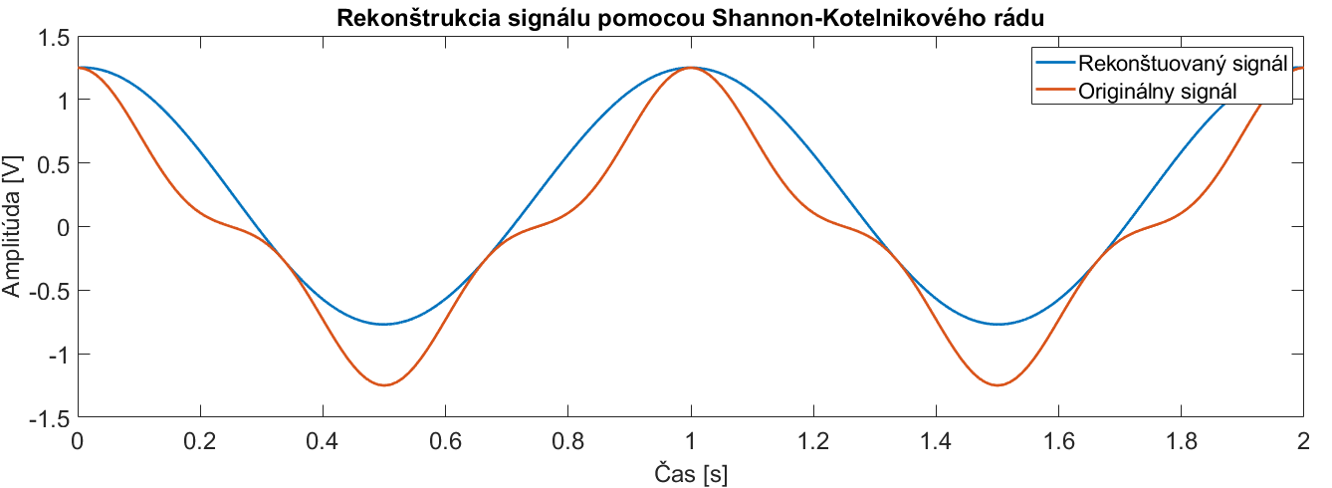
Úloha 2 – riešenie, $f_{D}=f_{MAX}$
n | 0 | 1 | 2 | 3 | 4 | 5 | 6 | 7 | 8 | 9 | 10 | 11 | 12
nTd | 0 | 0.333 | 0.667 | 1 | 1.333 | 1.667 | 2 | 2.333 | 2.667 | 3 | 3.333 | 3.667 | 4
f(nTd) | 1.25 | -0.25 | -0.25 | 1.25 | -0.25 | -0.25 | 1.25 | -0.25 | -0.25 | 1.25 | -0.25 | -0.25 | 1.25

Slide 14
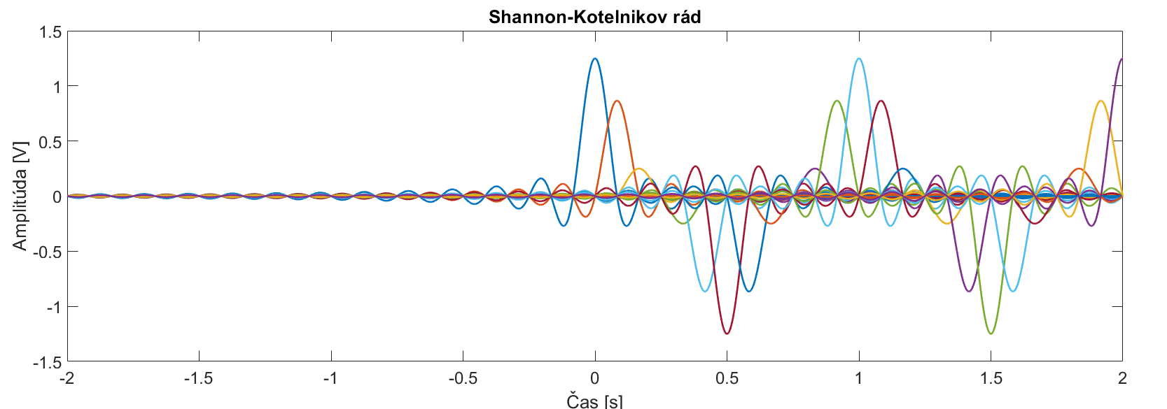

Úloha 2 – riešenie, $f_{D}={4f}_{MAX}$
n | 0 | 1 | 2 | 3 | 4 | 5 | 6 | 7 | 8 | 9 | 10 | 11 | 12
nTd | 0 | 0.083 | 0.167 | 0.25 | 0.333 | 0.417 | 0.5 | 0.583 | 0.667 | 0.75 | 0.833 | 0,917 | 1
f(nTd) | 1.25 | 0.87 | 0.25 | 0 | -0.25 | -0.87 | -1.25 | -0.87 | -0.25 | 0 | 0.25 | 0.87 | 1.25

Slide 15
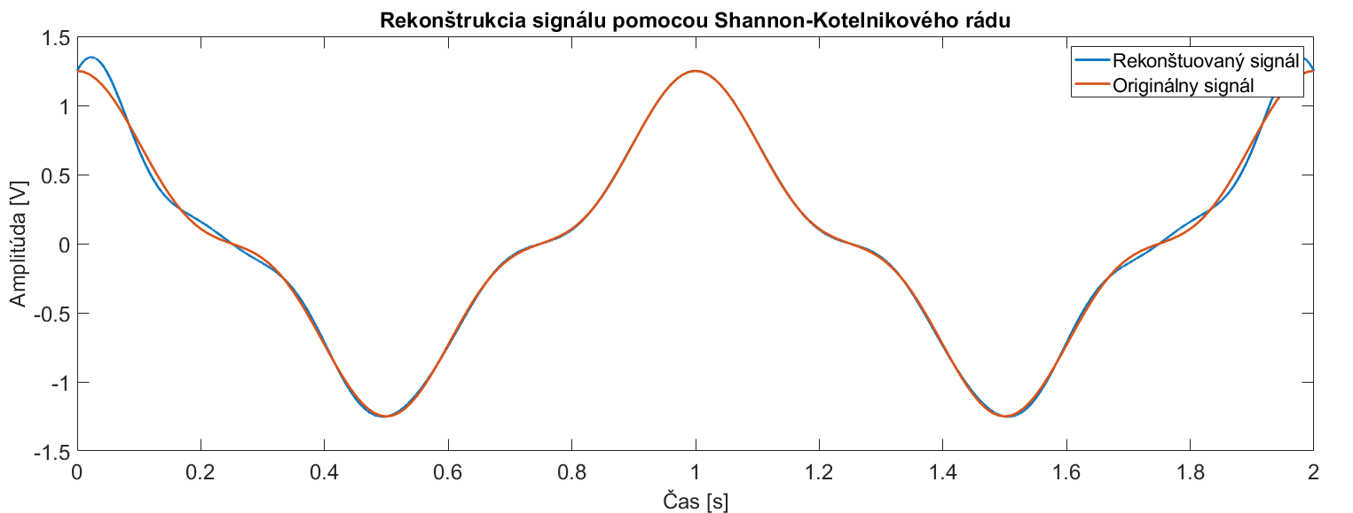
Úloha 2 – riešenie, $f_{D}={4f}_{MAX}$
n | 0 | 1 | 2 | 3 | 4 | 5 | 6 | 7 | 8 | 9 | 10 | 11 | 12
nTd | 0 | 0.083 | 0.167 | 0.25 | 0.333 | 0.417 | 0.5 | 0.583 | 0.667 | 0.75 | 0.833 | 0,917 | 1
f(nTd) | 1.25 | 0.87 | 0.25 | 0 | -0.25 | -0.87 | -1.25 | -0.87 | -0.25 | 0 | 0.25 | 0.87 | 1.25

Slide 16
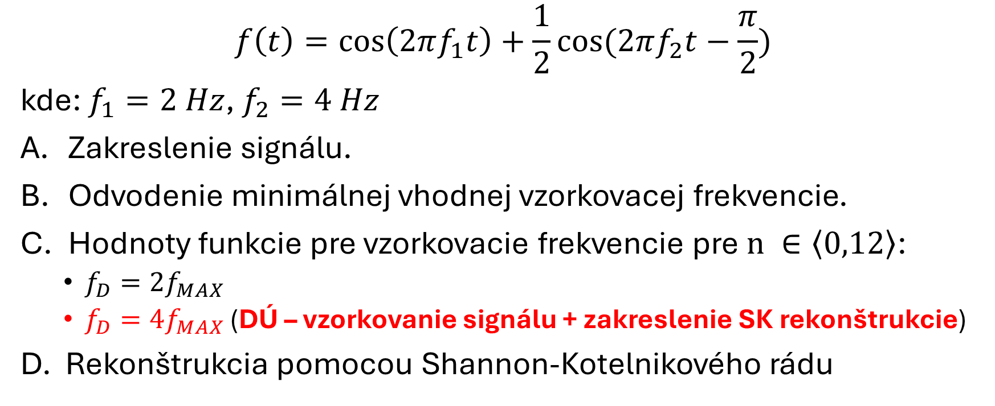
Úloha 3
$$f\left(t\right)=\cos\left(2πf_{1}t\right)+\frac{1}{2}cos⁡(2πf_{2}t−\frac{π}{2})$$
kde: $f_{1}=2 Hz$, $f_{2}=4 Hz$
Zakreslenie signálu.
Odvodenie minimálnej vhodnej vzorkovacej frekvencie.
Hodnoty funkcie pre vzorkovacie frekvencie pre$n ∈\left\langle 0,12\right\rangle$:
  $f_{D}={2f}_{MAX}$
  ${f_{D}=4f}_{MAX}$ (DÚ – vzorkovanie signálu + zakreslenie SK rekonštrukcie)
D. Rekonštrukcia pomocou Shannon-Kotelnikového rádu

Slide 17
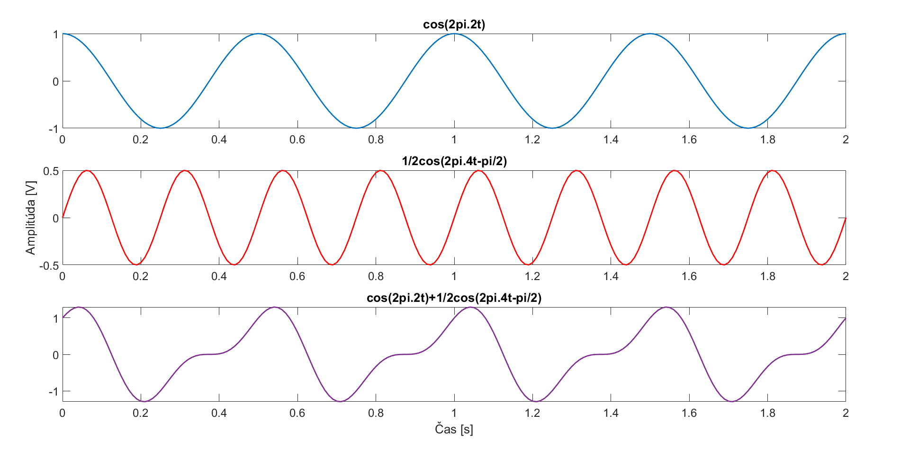
Úloha 3a) – riešenie

Slide 18
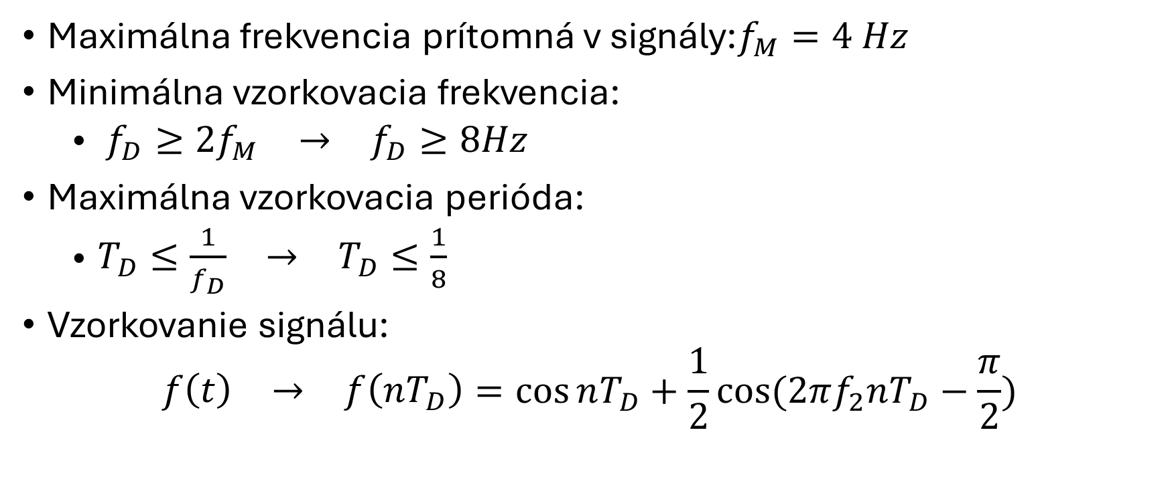
Úloha 3b) – riešenie
Maximálna frekvencia prítomná v signály:$f_{M}=4 Hz$
Minimálna vzorkovacia frekvencia:
  $\begin{matrix}f_{D}≥{2f}_{M} & → & f_{D}≥8Hz\end{matrix}$
Maximálna vzorkovacia perióda:
  $\begin{matrix}T_{D}≤\frac{1}{f_{D}} & → & T_{D}≤\frac{1}{8}\end{matrix}$
Vzorkovanie signálu:
$$\begin{matrix}f\left(t\right) & → & f\left(nT_{D}\right)\end{matrix}=\cos{nT_{D}}+\frac{1}{2}cos⁡(2πf_{2}nT_{D}−\frac{π}{2})$$

Slide 19
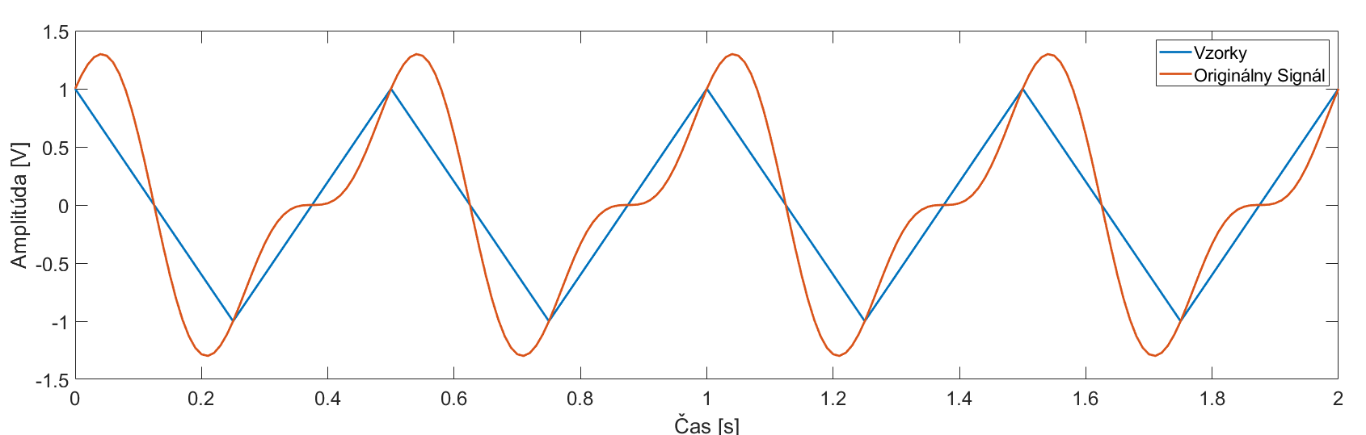
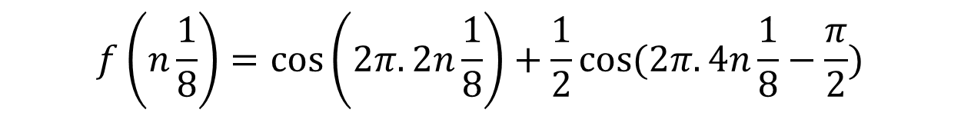

Úloha 3c) – riešenie, $f_{D}={2f}_{MAX}$
n | 0 | 1 | 2 | 3 | 4 | 5 | 6 | 7 | 8 | 9 | 10 | 11 | 12
f(n) | 1 | 0 | -1 | 0 | 1 | 0 | -1 | 0 | 1 | 0 | -1 | -0 | 1
$$f\left(n\frac{1}{8}\right)=\cos\left(2π.2n\frac{1}{8}\right)+\frac{1}{2}cos⁡(2π.4n\frac{1}{8}−\frac{π}{2})$$

Slide 20
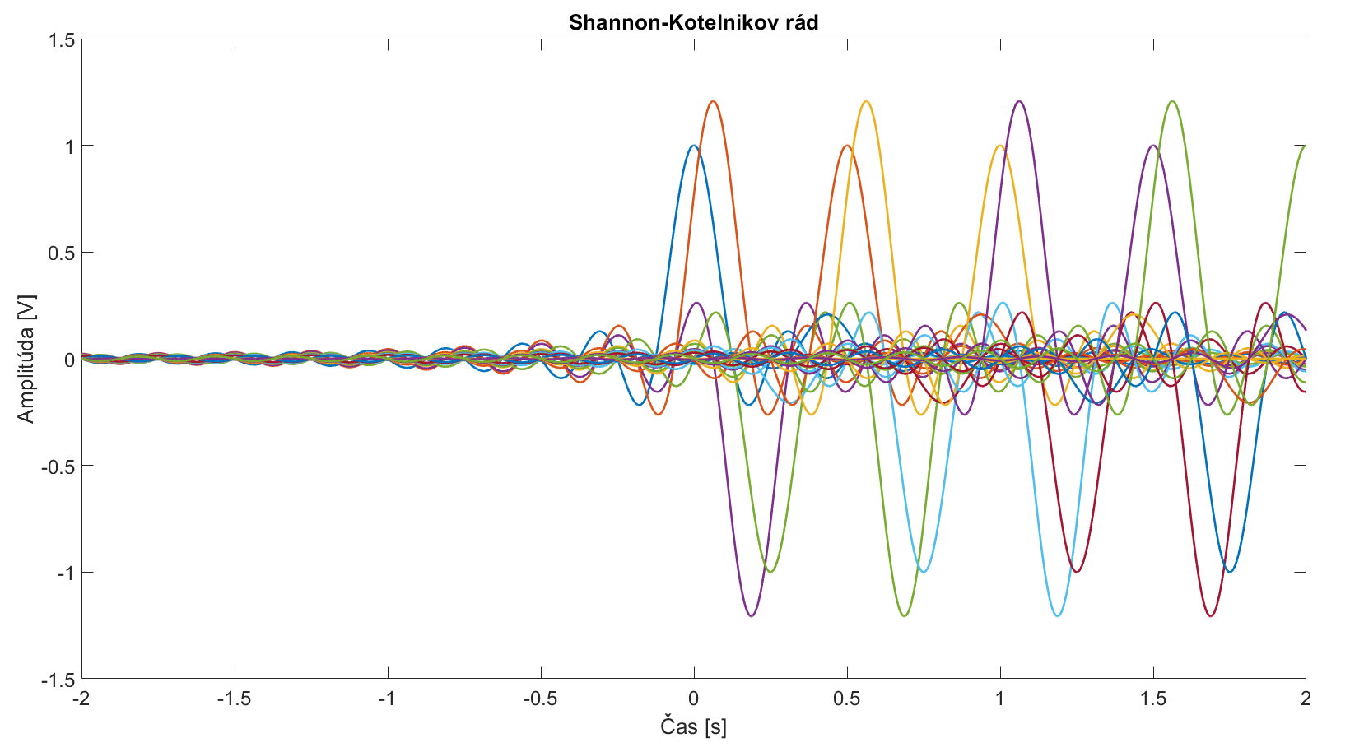

Úloha 3d) – SK rád, $f_{D}={2f}_{MAX}$

Slide 21
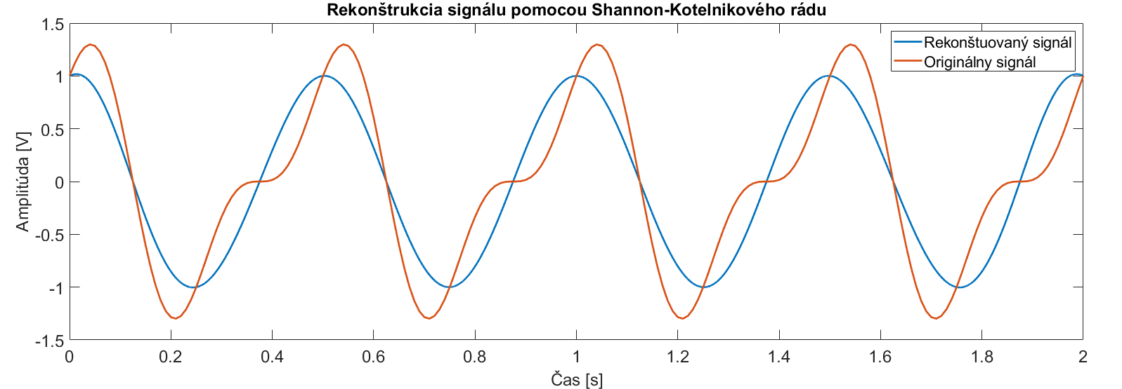
Úloha 3d) – SK rád, $f_{D}={2f}_{MAX}$

